Slide 1
HOME MONITORING SYSTEM
David Wachenschwanz
Fall 2017 UCSC IoT x413

Slide 2
Home Monitoring System Description
Multiple Inexpensive “dumb” Sensors Throughout Home Including Outdoors
9 Sensors Used in Demo
Each sensor contains Moteino (Atmel Atmega328 MCU), HopeRF RFM69HCW ISM Transceiver, Bosch BME280 and 18650 PCB-Protectd 3.7V Li-Ion Battery (2600 mAh)
Transmits Temperature, Pressure, Humidity & Battery Voltage ~ Once-per-Minute, Otherwise goes into Deep Sleep Mode to Preserve Battery Life
Programmed in C++ Using Arduino Development Environment
1st Raspberry Pi 3 Gateway
HopeRF RFM69HCW Transceiver connected to SPI0 for received data from “dumb” sensors
MQTT Gateway: C program running as daemon to receive data from “dumb” sensors and then publish data by MQTT over internal network. RFM69HCW connected by SPI0 and GPIO lines for interrupts
2nd Raspberry Pi 3 Gateway
MQTT-to-MongoDB Service: Python program running as a Linux service to subscribe to MQTT stream and save Temperature, Pressure, Humidity and Battery Voltage data to a MongoDB database
Flask Server: Flask server for providing overview of current sensor readings as well as for plotting data over a specific time period by location
Gigabyte Mini PC GB-BXi5-4570R: Hosting MongoDB in Ubuntu 16.04 LTS Linux
NOTE: In the future, the MQTT Gateway and MQTT-to-MongoDB Service may be combined into one service and the MQTT portion eliminated.

Slide 3
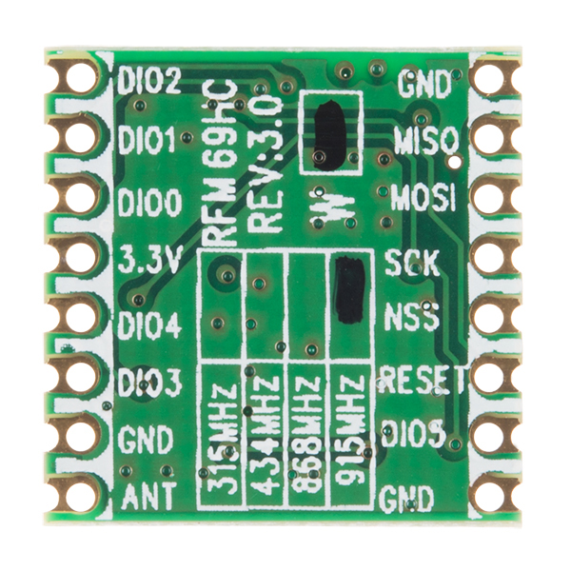
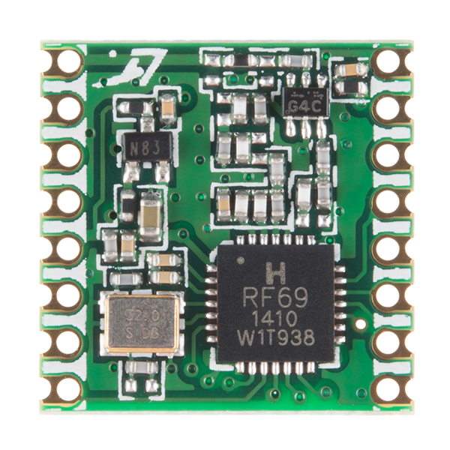
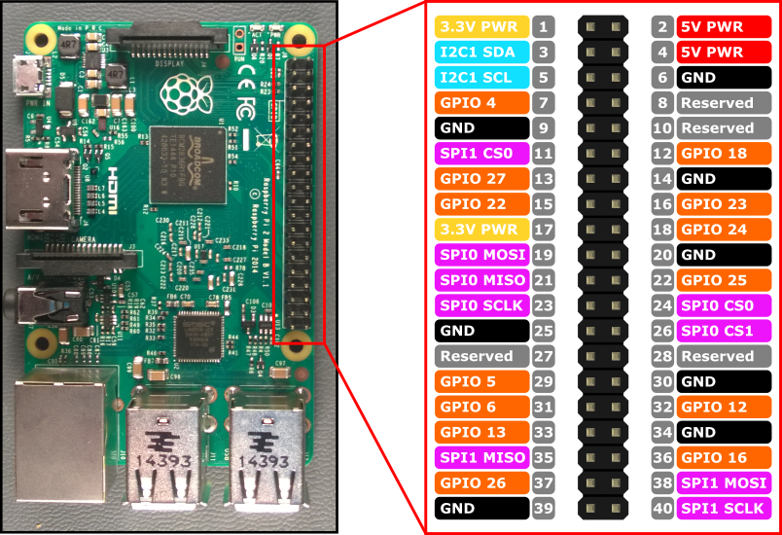
Raspberry Pi 3 with RFM69HCW Transceiver
RFM69HCW Back
RFM69HCW Front
RFM69HCW transmits at 915 MHz
300 kb/sec data rate
128-bit AES hardware encryption
Max. 255 nodes per network
Range: >500 meters line-of-site
Wiring Connections (RFM69 to Pi):
3.3V to pin 17
GND to pin 20
SLCK to pin 23
MISO to pin 21
MOSI to pin 19
NSS to pin 24
DID0 to pin 22

Slide 4
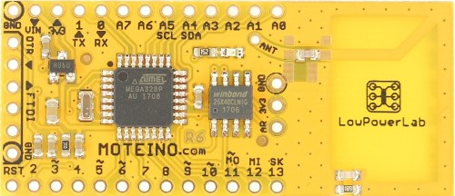
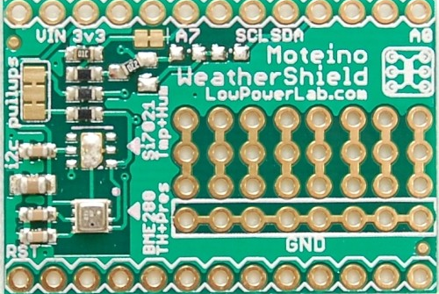
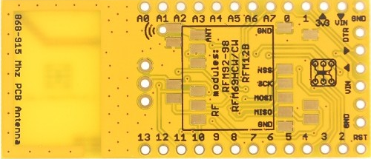

Moteino with RFM69HCW Transceiver & BME280 Shield
Moteino Front
BME280 Shield
Onboard battery monitor from VIN, reading on A7, through a 2/3 (1MEG+2MEG resistor divider) and p-channel MOSFET to control powering on & off.
Moteino Back w/RFM69HCW
Supplier: https://lowpowerlab.com

Slide 5
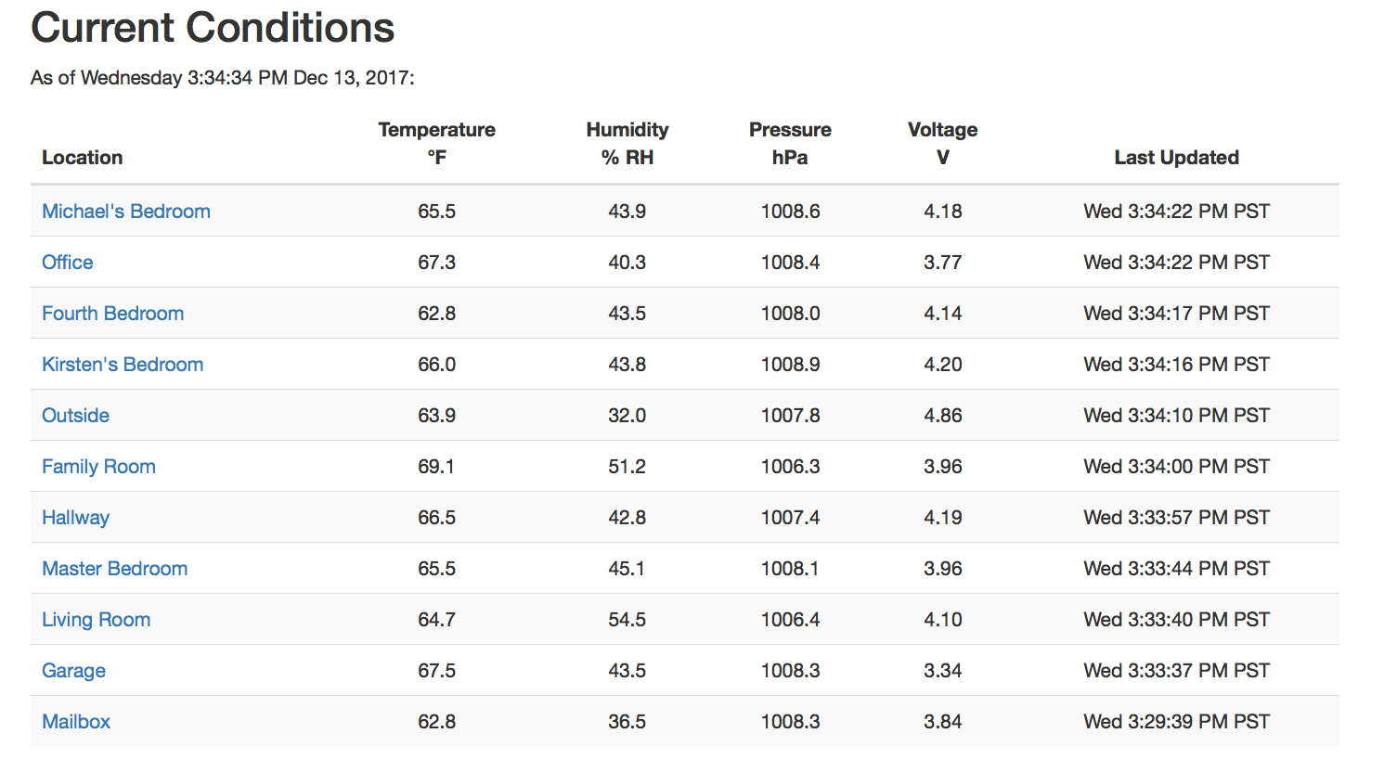
Index Page for Home Monitoring Website

Slide 6
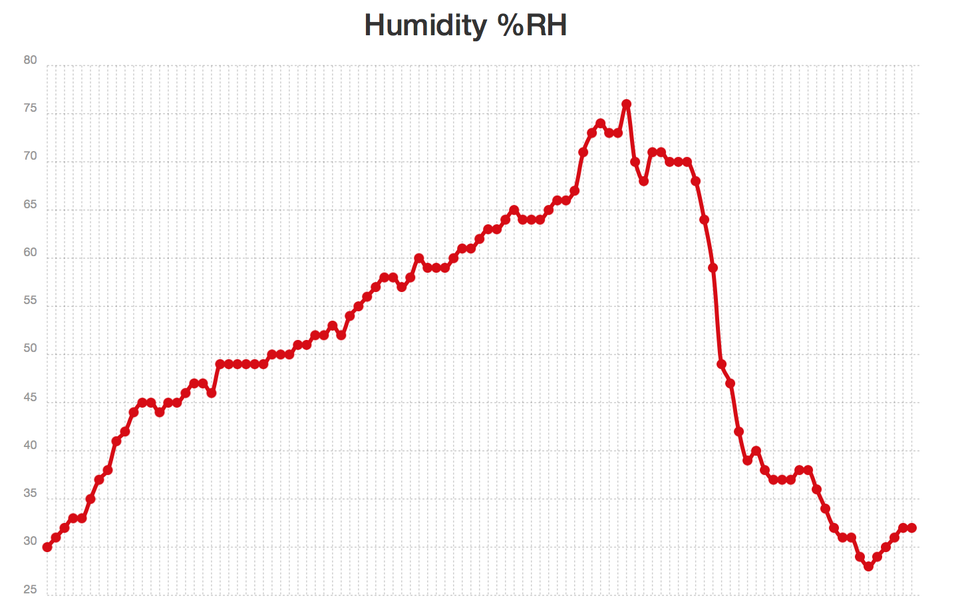
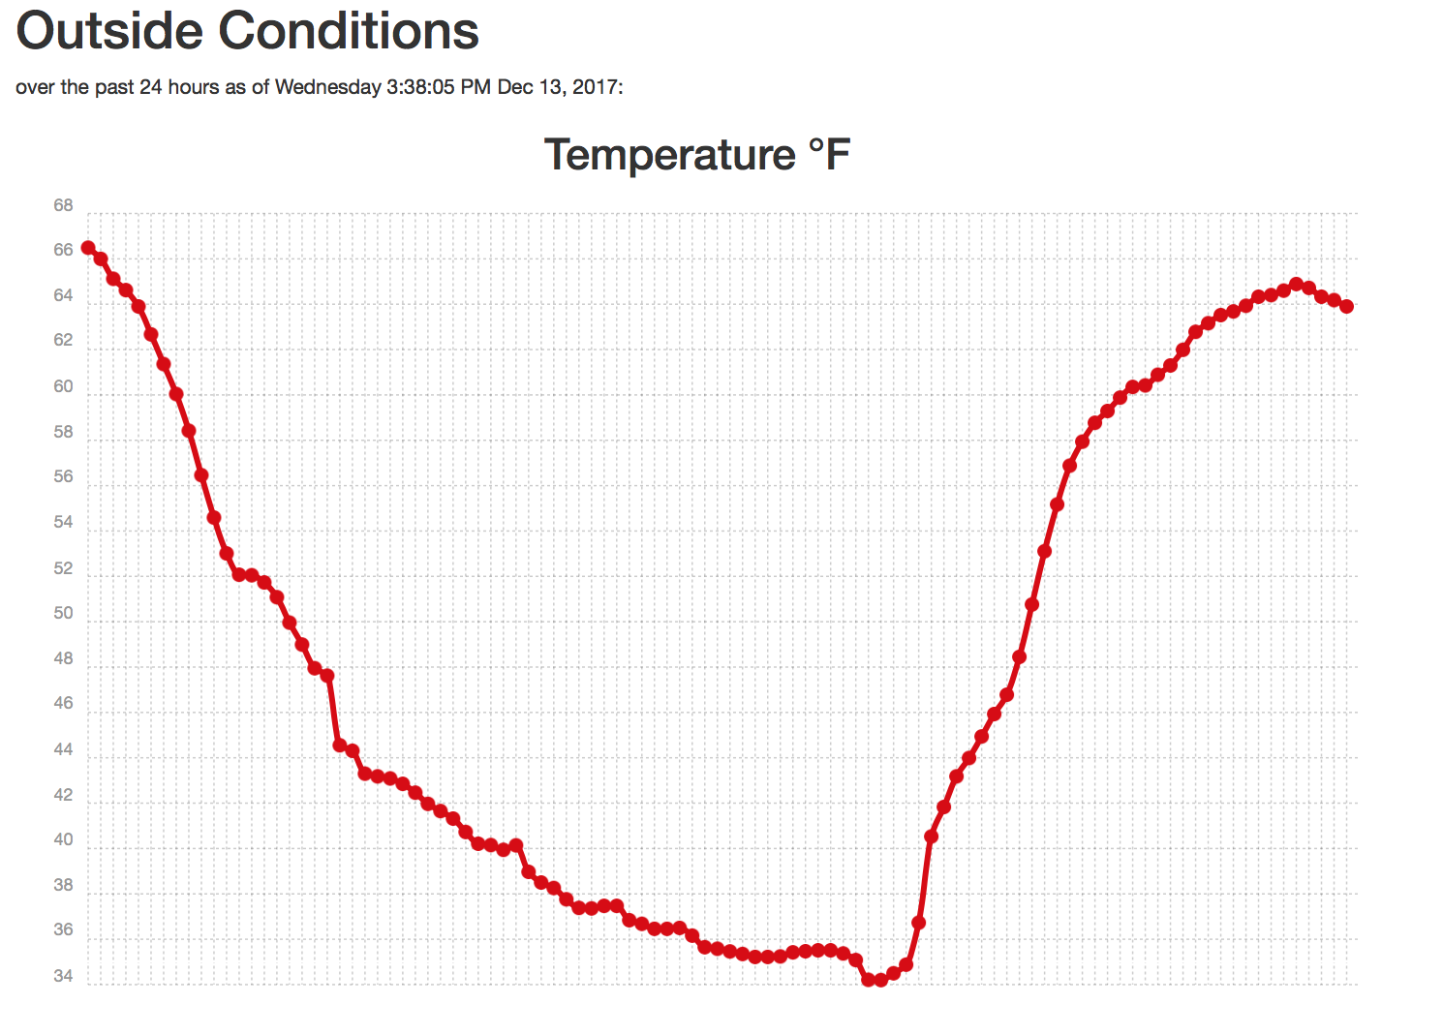
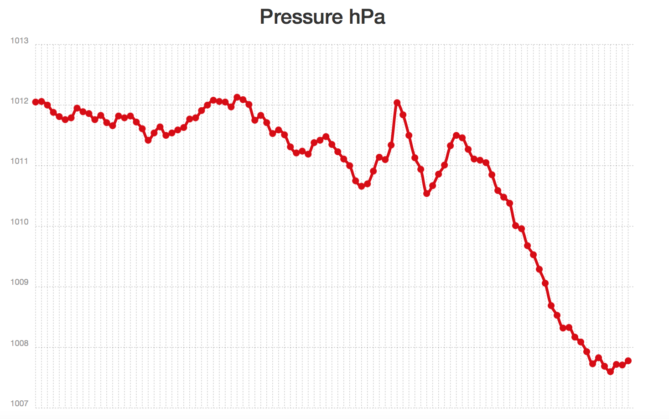
Specific Location Conditions (Reached by clicking on Location)

Slide 7
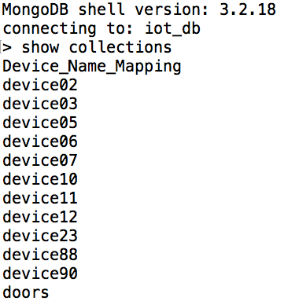
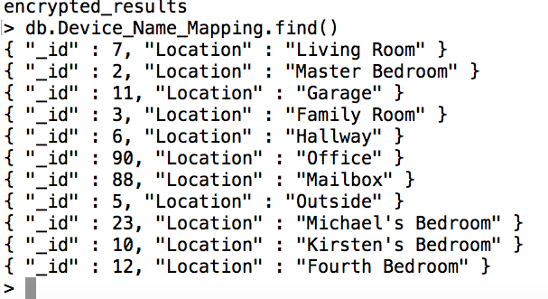
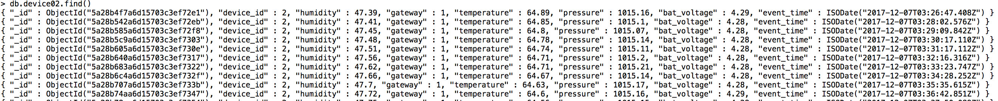
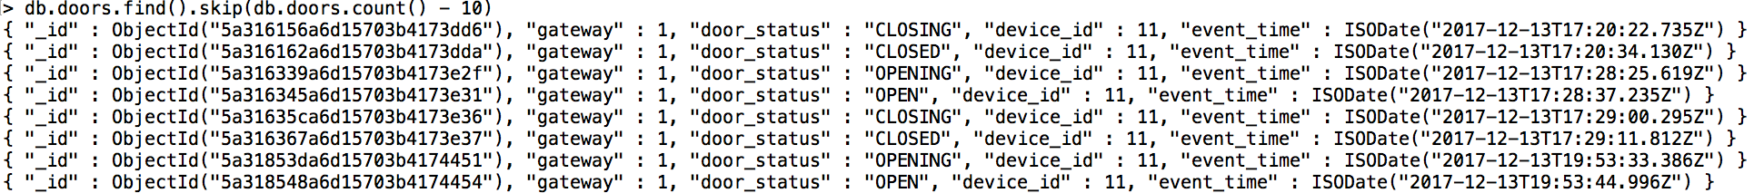
mongoDB iot_db database
Documents in Device_Name_Mapping Collection
Collections in iot_db
Documents in device02 Collection (device02 is the Master Bedroom
Documents in doors collection (“device_id”: 11 is the Garage

